Slide 1
EB Reporting PT
David Gerbec
EBSG 5th of March 2018

Slide 2
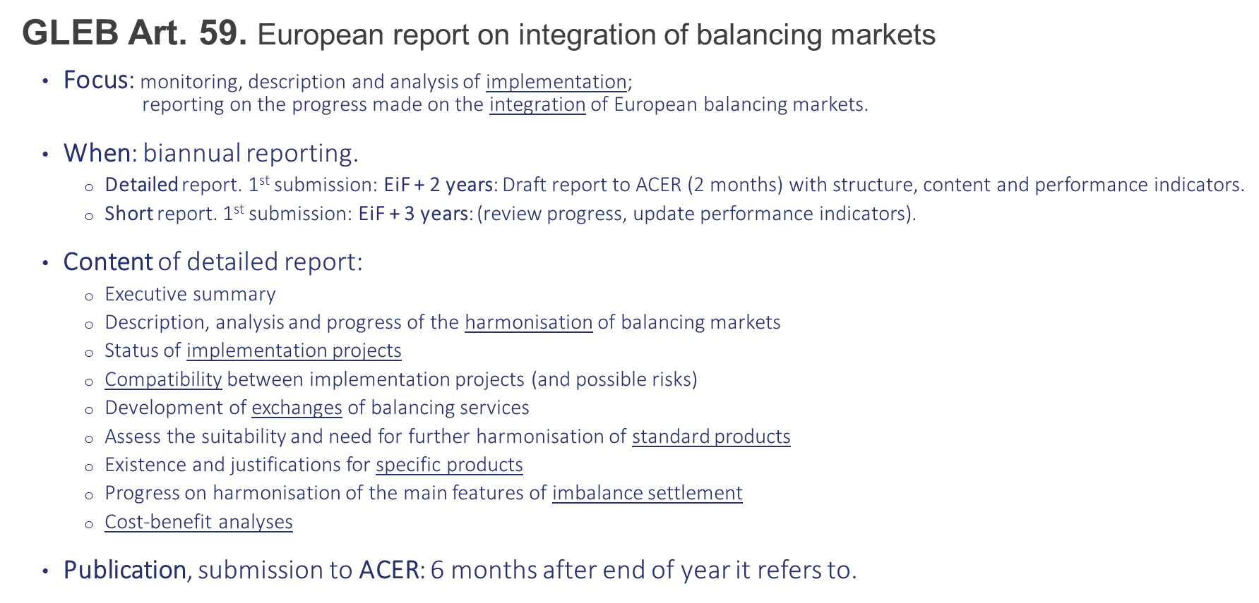
Legal requirements: GLEB

Slide 3
Legal requirements: GLEB
GLEB Art. 63. Monitoring
Focus: Monitoring of the implementation and effects of the GLEB.
Content of report (at least):
Preparation of the European report (Art. 59).
Preparation of a report on monitoring of the implementation of GLEB and effect on the harmonisation of applicable rules aimed at facilitating market integration
N.B.: same scope than ENTSO-E general monitoring obligations under Art. 8(8) Reg. 714/2009
Preparation monitoring: ENTSO-E to prepare a monitoring plan, for ACER opinion EiF + 6m; 18 June 2018
Data provision for monitoring:
ACER (in cooperation with ENTSO-E) will make a list of relevant information to be communicated by ENTSO-E, EiF +12m. (18 December 2018)
TSOs and market participants to make data available to ENTSO-E.

Slide 4
Deliverables
Which are the deliverables that the GLEB says that PT EB Monitoring needs to prepare? | When?
European report: Detailed + short | Art. 59. 18 June 2020
Draft European report to ACER | Art. 59. Not indicated, before submission of European report (at least 2 months for amendments).
Manual of procedures | Art. 12. EiF + 4 M; 18 April 2018
Monitoring plan | Art. 63. EiF + 6 M; 18 June 2018
Report on monitoring of implementation of GLEB (Proposal: to be combined with the European report) | Art. 63(1.b). To be defined in the Monitoring plan. Proposal: 18 June 2020
List of information (ACER lead, in cooperation with ENTSO-E) | Art. 63.3. EiF + 12 M; 18 December 2018

Slide 5
Draft timeline

